Slide 1



ROAD TO RESTORATION
2025

Slide 2
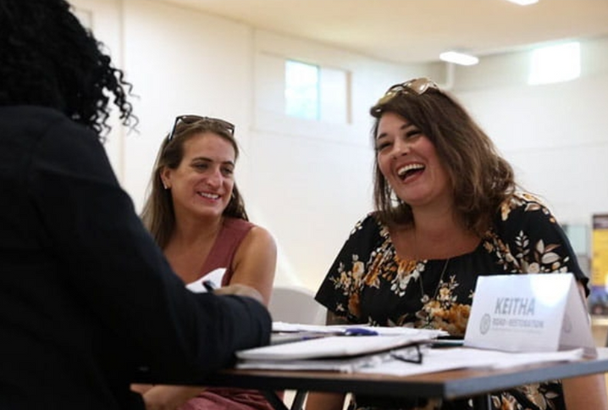
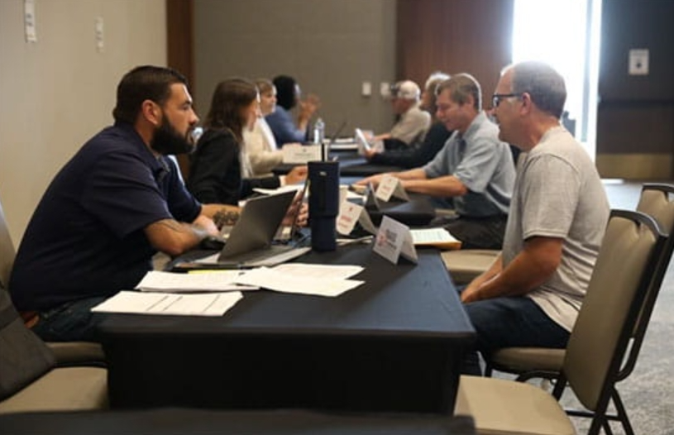
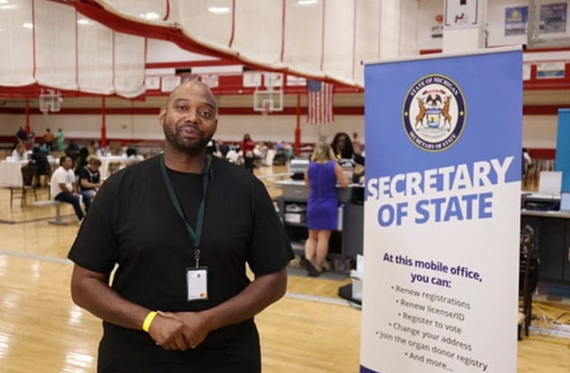
WHAT IS ROAD TO RESTORATION?
Road to Restoration is a series of free clinics to assist Michigan residents in understanding how to get their driving privileges restored.

Slide 3
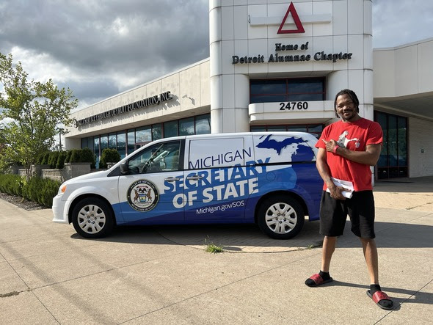
WHAT IS A CLINIC
We strive to gather resources that residents may need to regain their driving privileges:
  Mobile Secretary of State
  Triage (Experts from different departments within Michigan Department of State)
  Volunteer Attorneys
  Local courts (when available)
  Community partners
Notes:
Ask Rebecca/Chad to support content on this slide

Slide 4
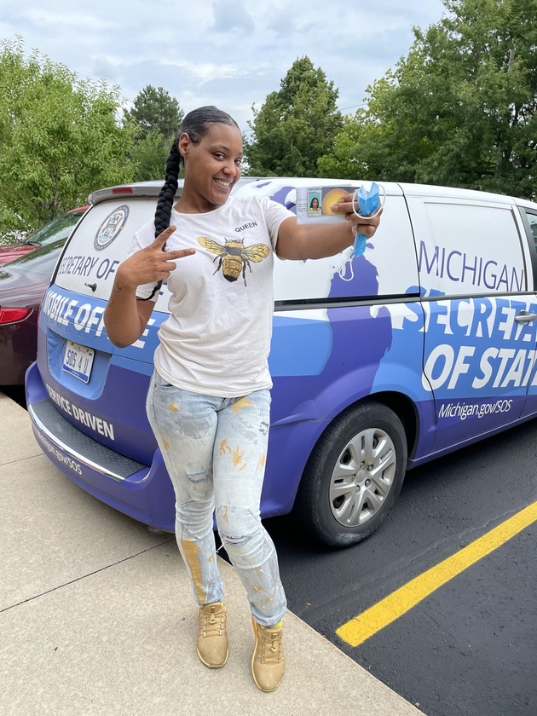
R2R BACKGROUND
  Launched in 2022
  Nearly 10,000 residents searved thus far
  Annual partners include 211, Michigan Department of Attorney General, Detroit Justice Center, DTE, United Way, Michigan Works!, Miller Canfield
Notes:
We strive to ensure that MDOC volunteers have approval before confirming them for the clinics: we want to make sure departments are staffed as needed AND that we don't have last-minute cancellations at the clinics.

Slide 5
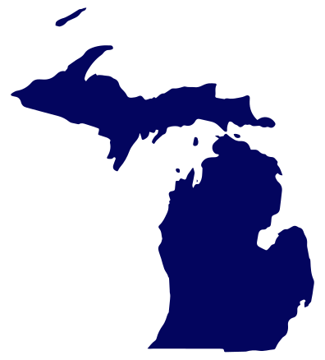
2025 R2R SEASON
  34 clinics total across the state of Michigan (5 have taken place already)
  5 clinics in MDOC facilities
  9 new-to-R2R cities/communities
Notes:
Most robust season to date
Goal to help residents across the state

Slide 6

Notes:
Volunteers are invited to attend pre-clinic prep call (via Teams) to review clinic timeline, what to expect on the day of the clinic, and any other training elements needed
Variety of volunteer positions available: clinics are a great way to connect with residents and help communities!

Slide 7
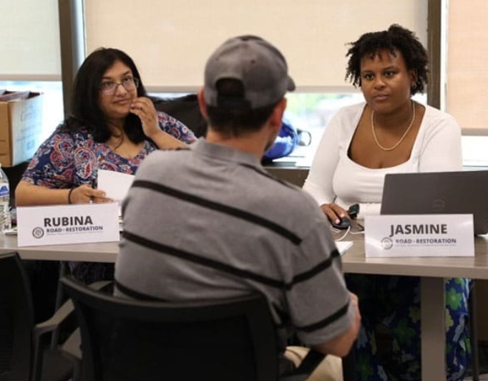
WAYS TO GET INVOLVED
1. Volunteer attorney at a clinic
  Virtual training in advance of the clinic
    combination of self-serve materials and 1-hour Zoom training (if schedules do not align, available via recording)
  Attend the clinic
    full day is appr. 9am-5pm, partial attendance can work!
    lunch provided

Slide 8
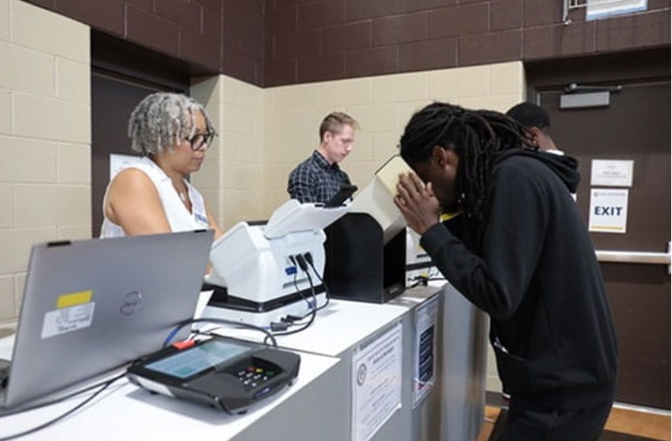
WAYS TO GET INVOLVED
2. Help us connect to your community
  Community organizations that may wish to provide information to residents at a clinic
  Getting the word out about upcoming clinics: sharing our digital assets online, ideas where physical fliers can be made available, other ideas on how to reach communities (local media, special Facebook groups, etc.)

Slide 9
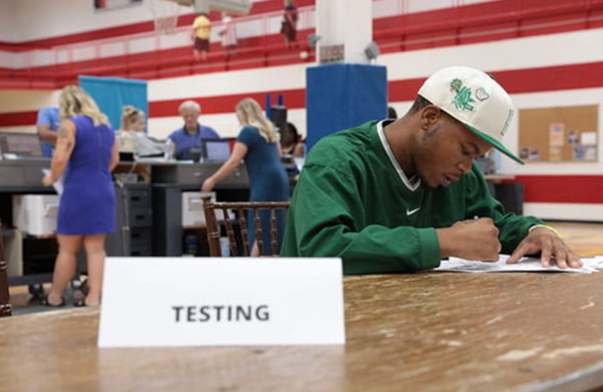
WAYS TO GET INVOLVED
3. Sponsorship ideas
We would welcome suggestions for companies/orgs that may be interested in sponsoring some resident costs:
  SOS sponsorships: arranged before the clinic, invoiced for exact amount after clinic
  Court fines/fees: paid directly to court on site during clinic, make arrangements with court to clear during the clinic

Slide 10
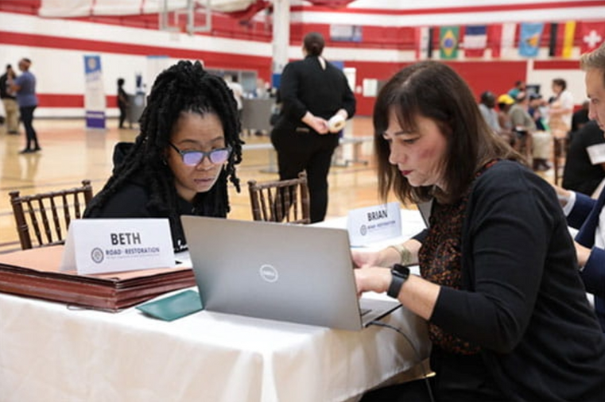
2/12/2025 | Ypsilanti (MDOC)
2/27/2025 | Jackson (MDOC)
3/6/2025 | Kalamazoo
3/11/2025 | Lansing
3/14/2025 | Benton Harbor
4/9/2025 | Royal Oak
4/22/2025 | Gaylord
4/24/2025 | Petoskey
4/25/2025 | Traverse City
4/30/2025 | Saginaw
5/6/2025 | St. Ignace
5/7/2025 | Newberry
5/9/2025 | Alpena
5/16/2025 | Grand Rapids
5/21/2025 | Pontiac
6/3/2025 | Ionia (MDOC)
6/6/2025 | Gladwin
6/10/2025 | St. Louis (MDOC)
6/11/2025 | St. Louis (MDOC)
6/17/2025 | Battle Creek
6/24/2025 | Detroit
7/31/2025 | Adrian
8/7/2025 | Holland
8/12/2025 | Bay City
8/20/2025 | Washtenaw Co.
8/27/2025 | Mt. Pleasant
9/9/2025 | Ironwood/Bessemer
9/10/2025 | Ontanogan
9/12/2025 | Marquette
9/17/2025 | Muskegon
9/25/2025 | Detroit
10/2/2025 | Roscommon
10/8/2025 | Flint
10/15/2025 | Dearborn
ANY QUESTIONS?

Slide 11
THANK YOU
www.Michigan.gov/R2R
Questions? Contact Abigayl Venman (venmana@michigan.gov)

